Slide 1
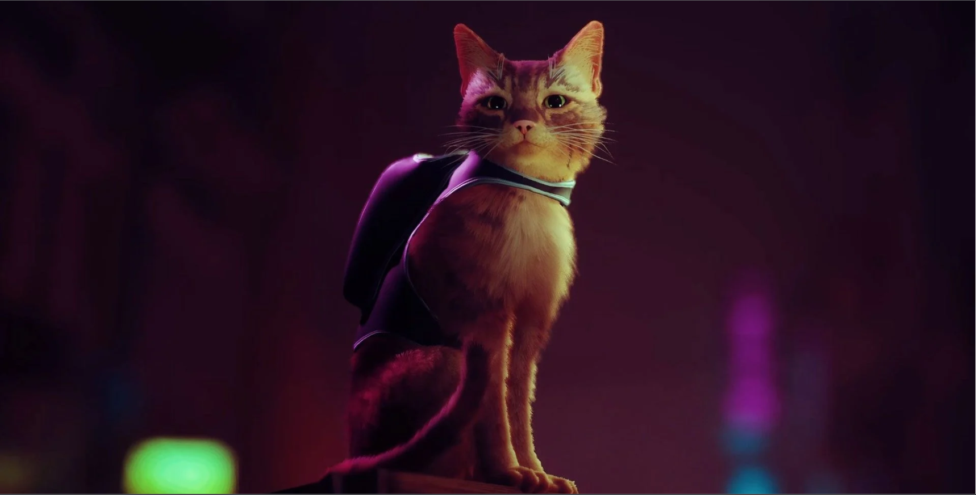
Feral

Slide 2
General Overview
Genre is a 3D puzzle platformer (think of something like Jump King combined with Human Fall Flat)
Various points where players can fall and lose progress
“Safe” points where there is no challenging platforming, but instead a puzzle/task has to be solved

Slide 3
Game Story
Players are thrust into the world through the eyes of Luna, a feral cat living in the heart of New York City
On a mission to rescue recently kidnapped kittens
Simple plot, linear and easy to follow

Slide 4
Game Story Cont.
NOT intended to be a story driven experience
Basic plot points provide fundamental context of the world and the purpose of Luna’s adventure
Emphasis on complimenting the game mechanics through story elements

Slide 5
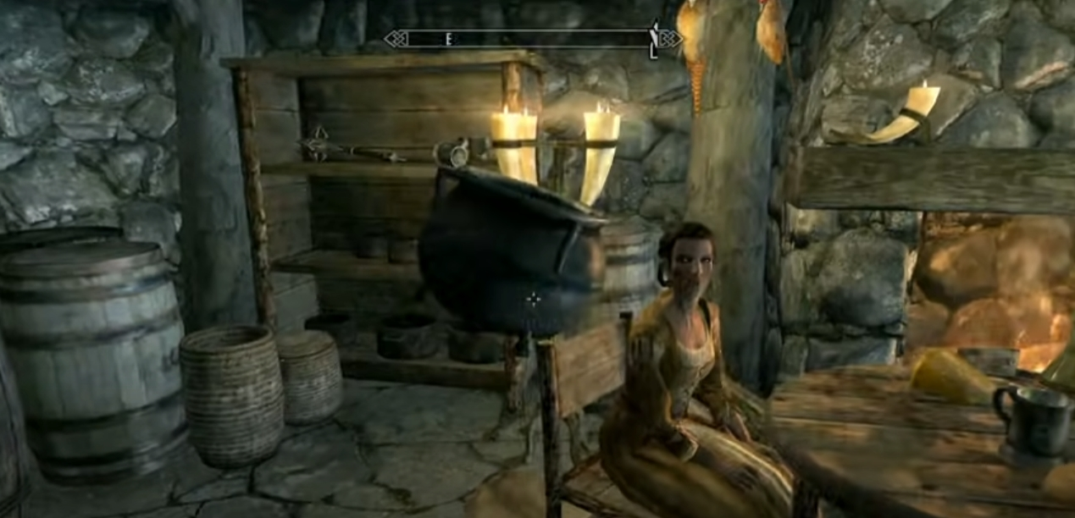
Game Mechanics
Picking up & Holding Objects:
Control: Hold LMB
Description: Allows the player to hold and move various objects within the world. Objects will float directly in front of the player as opposed to having a holding animation.

Slide 6
Game Mechanics Cont.
Throwing Objects:
Control: Press RMB
Description: Item being held by the player will be thrown in the direction the player is looking. This mechanic will be important when solving various puzzle challenges. (Throwing items into desired areas, breakable items)

Slide 7
Game Mechanics Cont.
Jumping:
Control: Press SPACE
Description: Players will have 2 jumps (double jump). Jump charges will be recharged when the player collides with the ground.

Slide 8
Game Mechanics Cont.
Climbing:
Control: Hold SPACE + Directional Key (WASD)
Description: When colliding with a wall, players can hold SPACE + a directional key to climb. The distance the player will climb will be proportional to there horizontal & vertical velocity when the initial collision takes place.

Slide 9
Game Mechanics Cont.
Slacklines/Balancing:
Control: Press A & D
Description: A minigame activity where the player will perform a “balancing act” across tightrope-like terrain. Player will have to use A or D to ensure the character is not leaning too far in one direction.

Slide 10
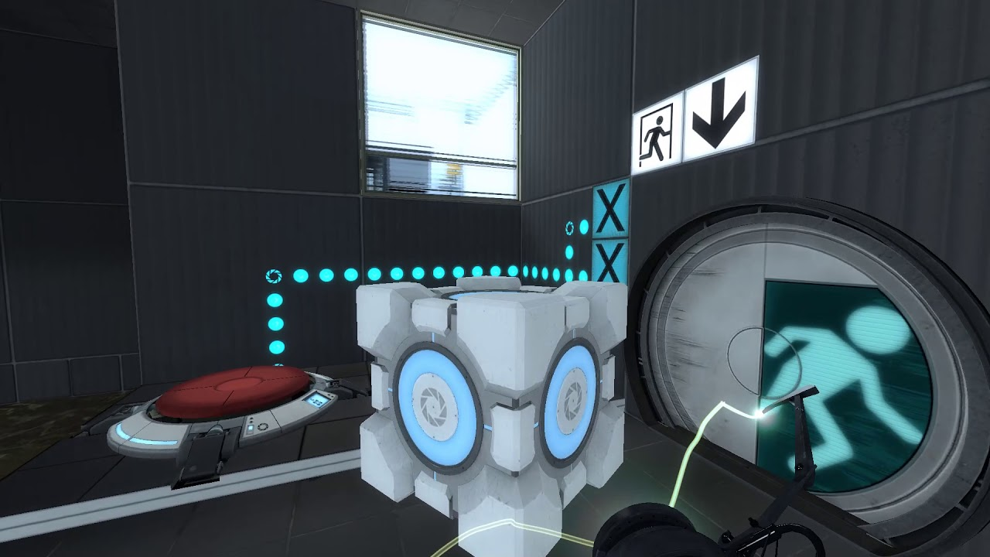
Game Mechanics Cont.
Pressure Plates:
Description: An interactable object in the world that will have a specific behaviour when the correct item is placed on top.

Slide 11
Game Mechanics Cont.
Interactive Doors:
Description: A “barrier” object in the world where the player will have to find various items and or complete difficult tasks to progress further in the game.
Openable by keys/key cards and pressure plates
Displaying the status of the door (ie: Locked, Press ‘E’ to open)

Slide 12
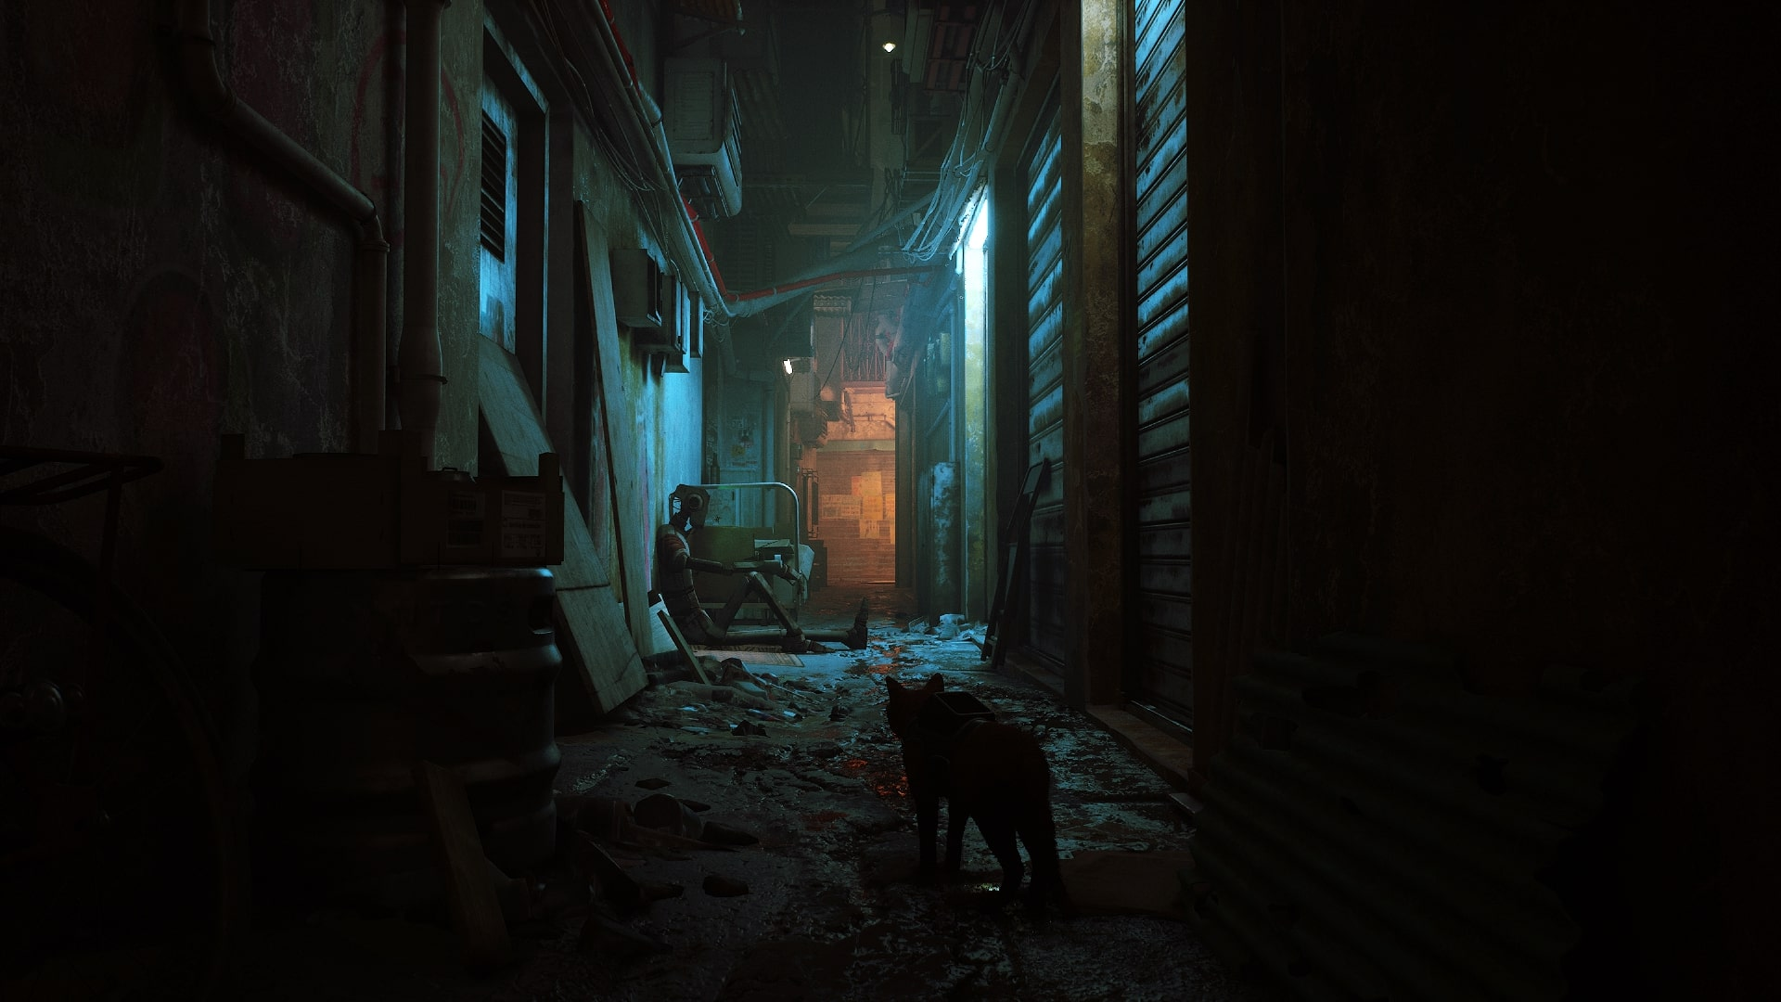
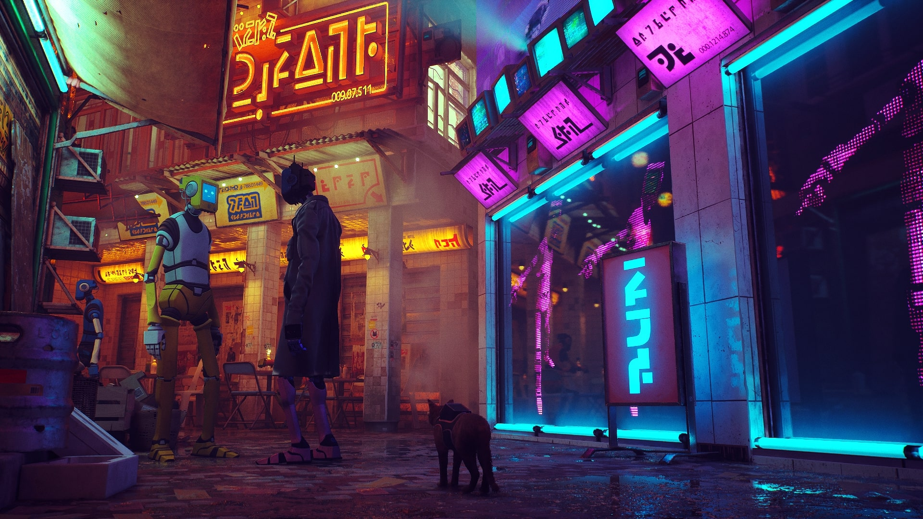
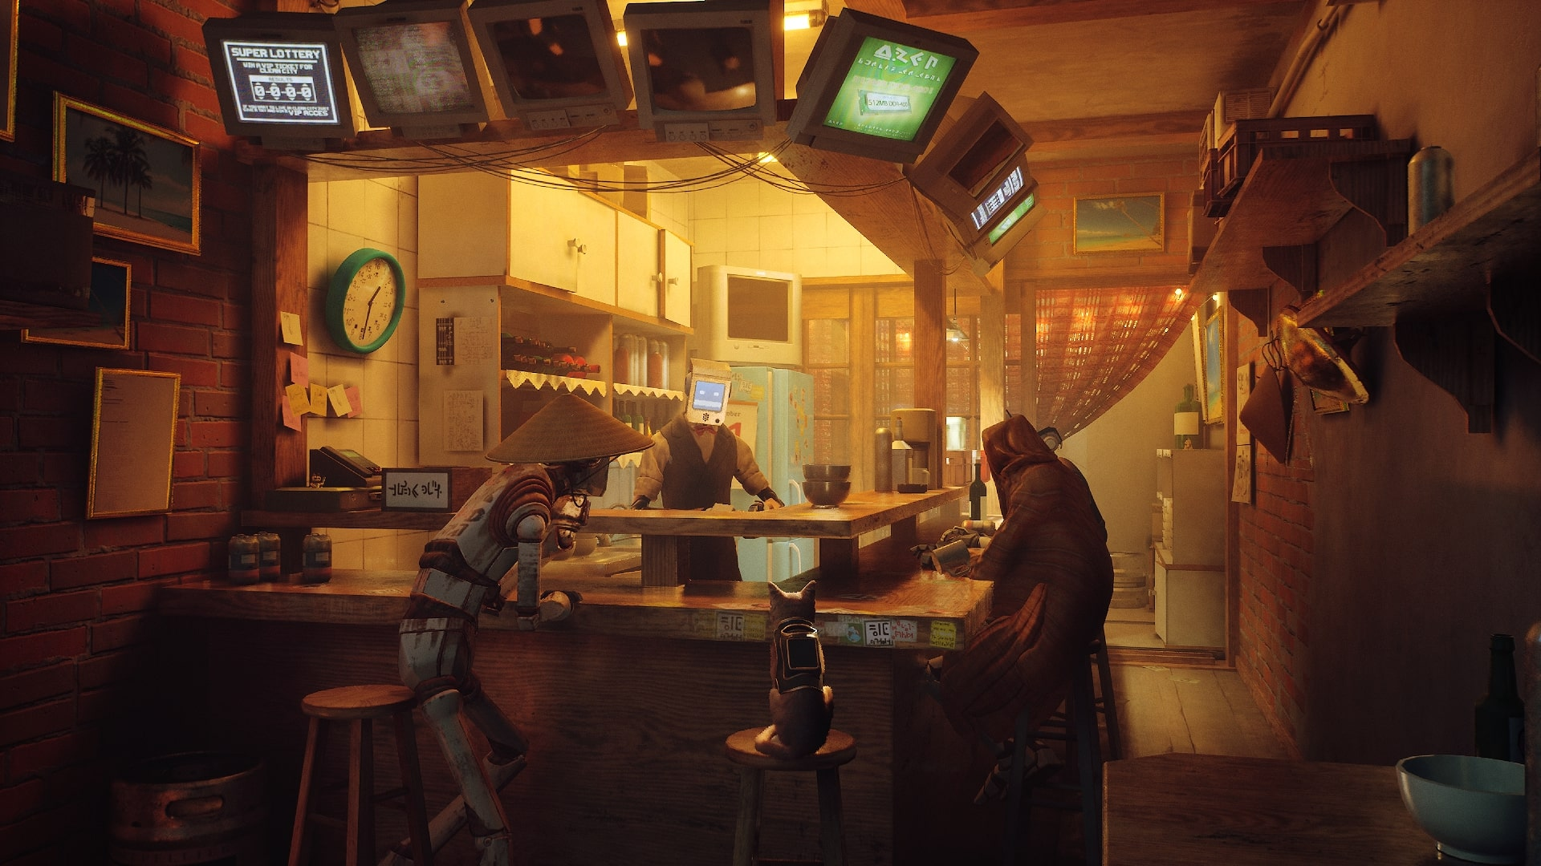
pics

Slide 13
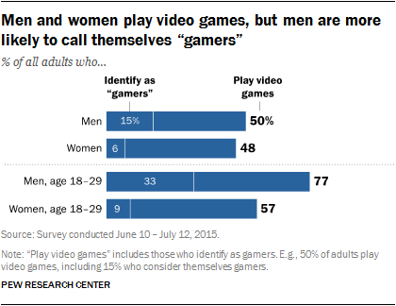
Target Audience
Casual Platformer Fan
Low barrier of entry
Broad subject matter appeal
Higher skill cap
Appeals to more experienced players
May limit accessibility
Via: https://www.pewresearch.org/internet/2015/12/15/who-plays-video-games-and-identifies-as-a-gamer/
Notes:
The primary audience we are designing this game for is the casual platformer fan. These are people who may have played a 3D platformer in the past, but don’t necessarily identify themselves as a ‘gamer’.
We intend to appeal to this market by creating a relatable world (w/ realistic and familiar setting/character) but heightened and dynamic movement.
The goal is to make the experience seem recognizable and engaging. We hope that pairing this with a competitive price point will drive consumer attention.
While a broad appeal is our main goal, we also intend to make later sections of the game quite challenging in order to increase interest for more experienced players. We are aware that this may present accessibility concerns for some players in the initial prototype. During development, we will be mindful of different accessibility options we could introduce to ensure a wider variety of players could enjoy our game.

Slide 14

Target Audience Cont.
Speedrunners/Streaming Audience
Gameplay focused on momentum and flexible movement options
Immediately relatable world
High skill cap / Low barrier of entry
Footage via: https://www.youtube.com/watch?v=jeq11f7Ip3s
Notes:
Beyond our primary audience, we are also hoping to make the game appeal to speedrunners and streamers (as well as their audiences).
Finding our corner of this market will allow for a longer lifespan for the game and drive additional sales over time
Since the game is built around dynamic movement and puzzle solving options, we hope that the game will find an audience with these groups (similar to larger titles such as Super Mario Odyssey or smaller more comparable titles such as Mail Mole).
As players find new, faster ways to complete the game, spectators should be able to get a sense of what the game is about within a few seconds of viewing it and will hopefully be encouraged to pick the game up for themselves.

Slide 15






Monetary Strategy
One Time Purchase
Targeted Retail Price is approx. CDN$15
Comparable to other indie platformer games
* Prices via Steam as of January 2022
Expected Price Range
Notes:
We intend to release this game as a one time purchase. This felt like the tried and true approach for similar titles such as (read a few from list)
Note that some of these titles are 2D rather than 3D so we went slightly higher into the price range to account for the additional costs and considerations required for the development of a 3D game.
In line with these games, we are targeting a retail price of approx. $15 Canadian.
Since the scope of the game is relatively small we feel this price point puts us in line with what consumers could expect to pay for a similar title, rather than pricing it to compete with AAA puzzle/platformers.
Closer to the launch price of Portal (when released as standalone) rather than Portal 2

Slide 16
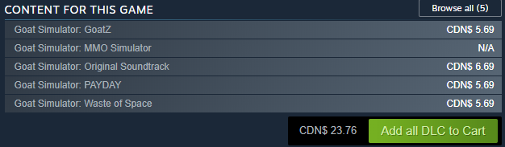
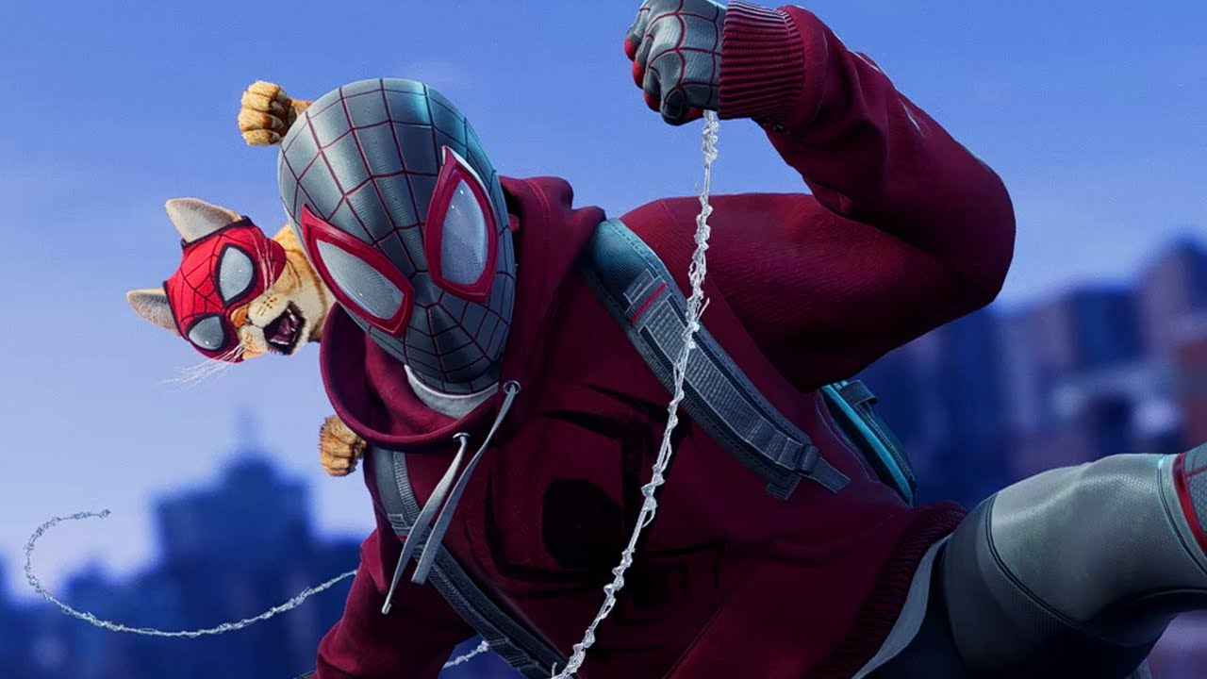
Additional Monetary Considerations
Two potential streams for generating further revenue:
Additional DLC Levels built on top of base game mechanics
Re-use of movement mechanics in a larger title to help offset development costs
Image via: https://www.riotbits.com/marvels-spider-man-miles-morales-how-to-get-the-bodega-cat-suit-4269/
Notes:
Beyond the one time purchase of the product, we are looking to additional channels to help drive revenue
These include the opportunity of DLC levels should the game see a longer than expected adoption rate. Adding additional maps will provide new options to add mechanics/challenges for the player.
These could either be priced as separate purchases or as free updates to the game to attract new players who may not have been sold on the initial offering
Beyond the game itself, our focus on gameplay mechanics over narrative allows for these mechanics to be re-used in further titles.
Since traversal options such as climbing and balancing are relatively ubiquitous mechanics, we could port over code developed as part of this title to a larger game in order to offset development costs.

